Slide 1


2017 HIV/AIDS Epidemiology profile
Cleveland/cuyahoga county
Cleveland Department of Public Health
Office of Communicable Disease Surveillance and Epidemiology
Presented by:
Katie Romig, MPH, SIT
Chief Epidemiologist
May 16, 2019

Slide 2
Newly Diagnosed Cases

Slide 3
2017 Cleveland/Cuyahoga County demographics
In 2017 there were 158 new HIV/AIDS cases reported; 105 (67%) were residents of Cleveland at the time of diagnosis
85% (n=134) of new cases were male
Highest number of new cases were under 30 years old (n=93); 62 (67%) of them were Cleveland residents at time of diagnosis
68% (n=107) of the cases were African-American; 59% (n=93) of the new cases were among African-American males.
78% (n=103) of cases were males who reported having sexual contact with another male (MSM) in the 12 months prior to diagnosis.

Slide 4
Incidence of HIV Cases by residency
 | Cuyahoga County Resident |  | Cleveland Resident
Age Group | # Cases | Incidence Rate+ | # Cases | Incidence Rate+
0-14 | * | * | * | *
15-19 | 15 | 19.9 | * | *
20-24 | 31 | 37.9 | 25 | 88.2
25-29 | 46 | 50.4 | 29 | 89.4
30-34 | 21 | 25.7 | 15 | 54.9
35-44 | 18 | 12.7 | 10 | 22.0
45-59 | 21 | 8.3 | 26 | 19.4
60+ | * | * | * | *
Total | 158 | 12.7 | 105 | 27.2
+ Rates are calculated per 100,000 persons based on 2017 American Community Survey estimates * Data are suppressed with fewer than 10 cases are observed for confidentiality

Slide 5
Prevalence and incidence
Prevalence (per 100,000 persons)
2017 Prevalence Rate for Cuyahoga County -> 449.2
2017 Prevalence Rate for Cleveland -> 964.4
    Prevalence refers to the number of new cases that develop plus existing cases in a population during specific time period.
Incidence (per 100,000 persons)
2017 Incidence Rate for Cuyahoga County -> 12.7
2017 Incidence Rate for Cleveland -> 27.2
  Incidence refers to the number of new cases of disease that develop in a population at risk for disease during specific time period.
2017 Incidence Rate for Ohio -> 8.7
*Cuyahoga County population denominator used: 1,248,514
*City of Cleveland population denominator used: 385,525
(2017 U.S. Census population estimates)
*Ohio incidence rate calculated using 2017 U.S. Census estimates
Notes:
5517/1,263,189 x 100,000 = 436.8
3696/390,584 x 100,000 = 946.3

Slide 6
Surveillance records
According to the HIV/AIDS surveillance records, there are 5605 cases in Cuyahoga County. Of those cases, 3718 cases were in Cleveland in 2017.

Slide 7
Newly Diagnosed Hiv Cases in Ages 20-24 yo
*2018 data are preliminary

Slide 8
Newly Diagnosed HIV cases in 24yo and younger
*2018 data are preliminary

Slide 9
Newly Diagnosed Hiv cases in our region

Slide 10
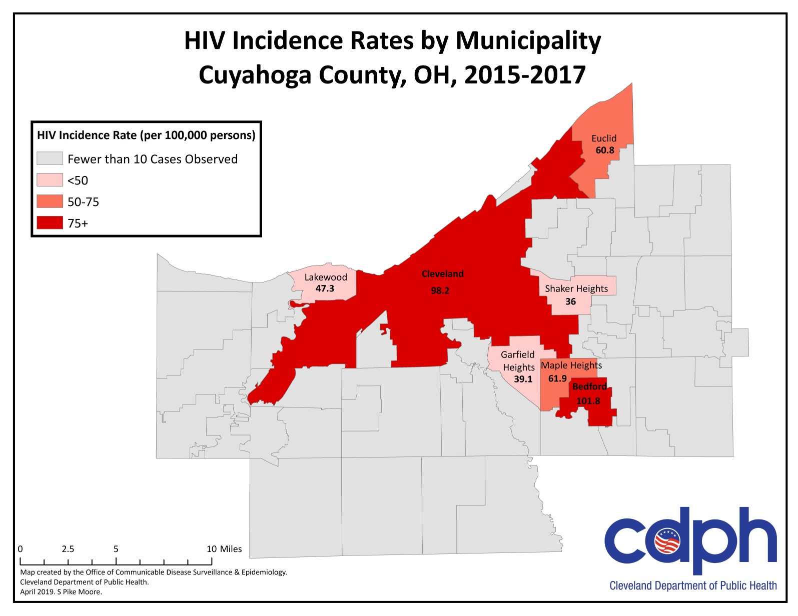
Incidence of Hiv cases by municipality, cuyahoga county

Slide 11
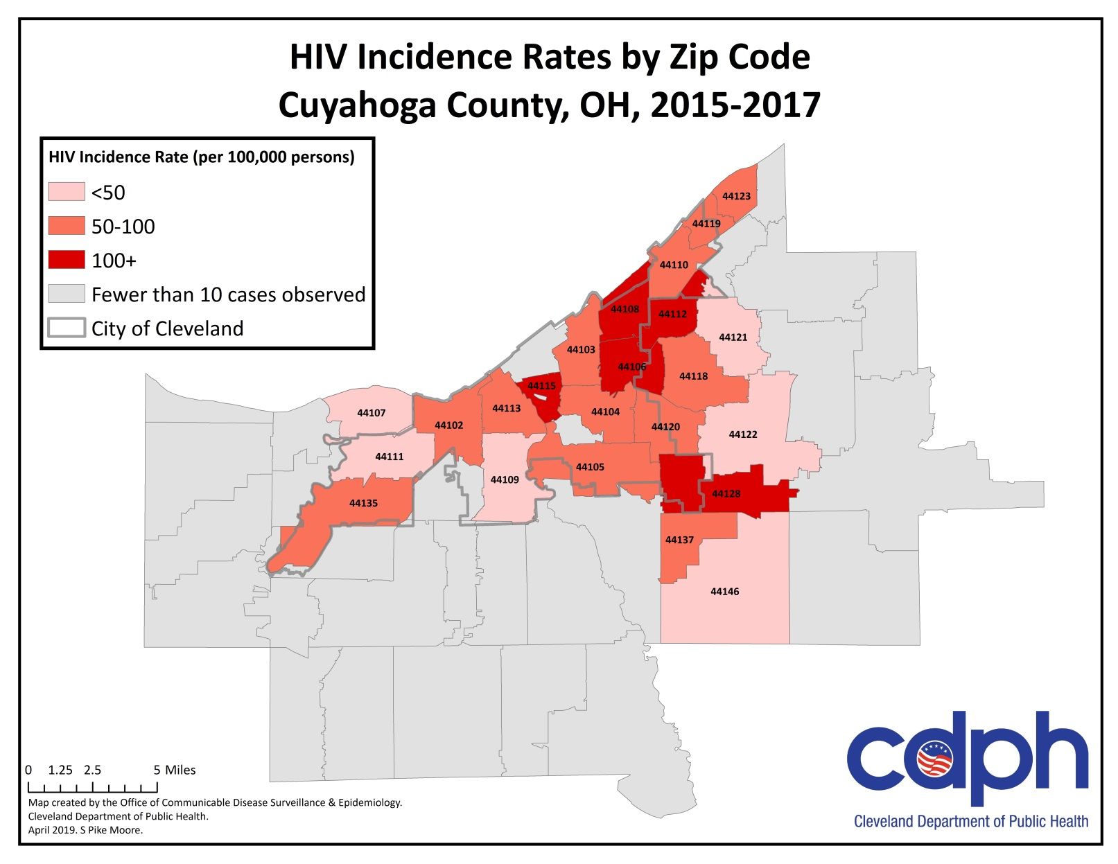
Incidence of HIV Cases by zip code

Slide 12
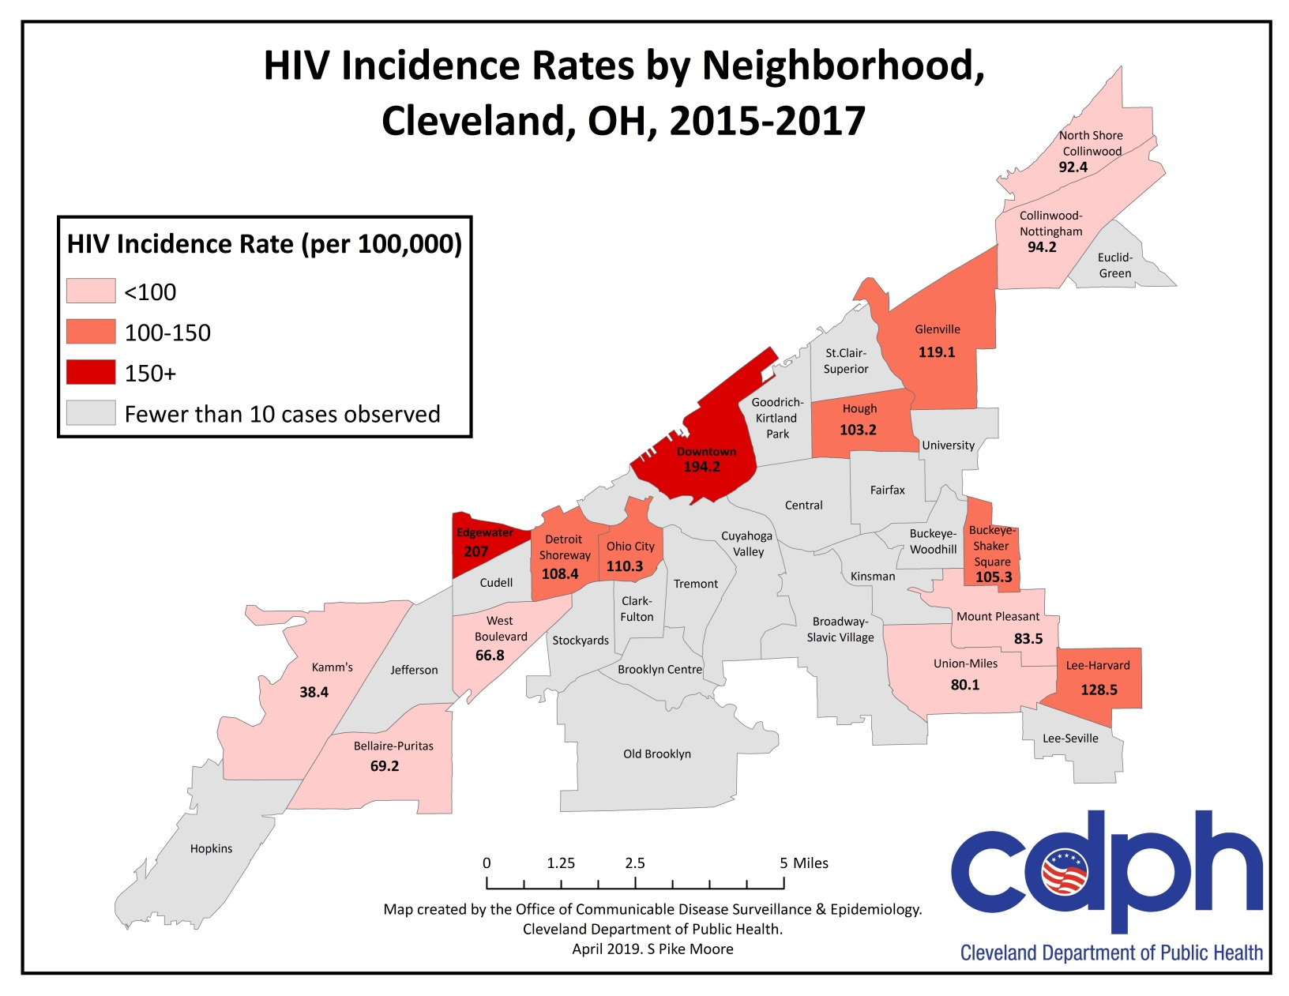
Incidence of Hiv cases by neighborhood, cleveland

Slide 13
Cuyahoga county, risk factors
65% (n=103) of cases were males who reported having sexual contact with another male (MSM) in the 12 months prior to diagnosis.
42% (n=67) of cases reported that were African American, had MSM exposure within the 12 months prior to diagnosis.
19% (n=30) of cases had a history of a sexually transmitted infection (STI).
18% (n= 29) of cases were co-infected with syphilis at the time they were also diagnosed with HIV

Slide 14
Diagnostic facilities

Slide 15
Persons living with HIV/AIDS

Slide 16
Persons living with HIV and AIDS in Cuyahoga County
4,940 people are currently living with HIV/AIDS in Cuyahoga County
  2,543 people are currently living with HIV in Cuyahoga County
  2,397 people are currently living with AIDS in Cuyahoga County

Slide 17
Other sexually transmitted infections

Slide 18
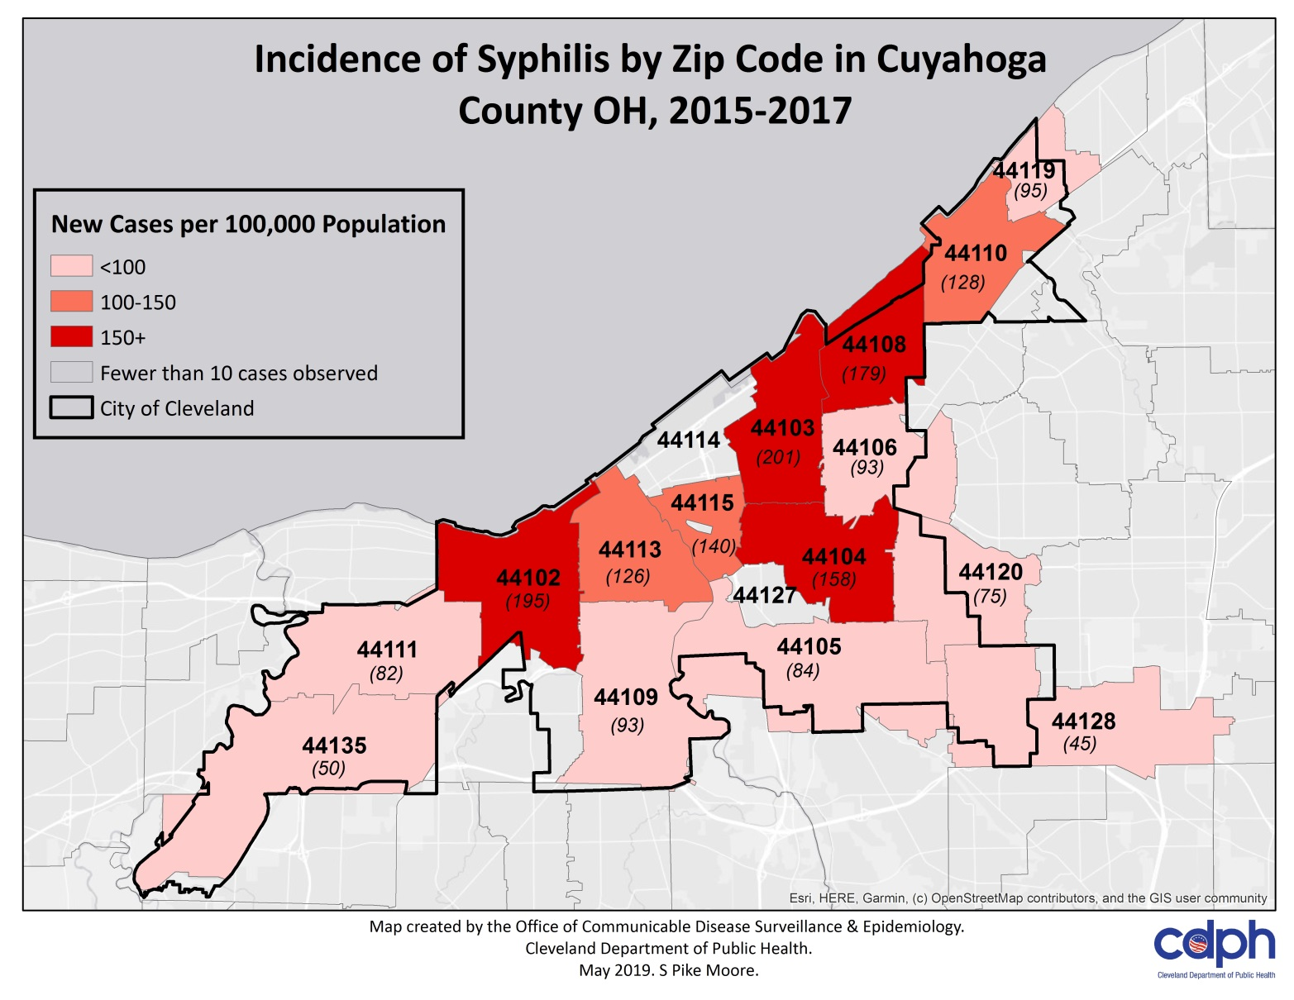
Incidence of syphilis by zip code, Cuyahoga county

Slide 19
New cases of syphilis
New Syphilis Diagnoses by Stage, Cuyahoga County, 2018
HIV Coinfection Status Among Newly Diagnosed Syphilis Cases, Cuyahoga County, 2018

Slide 20
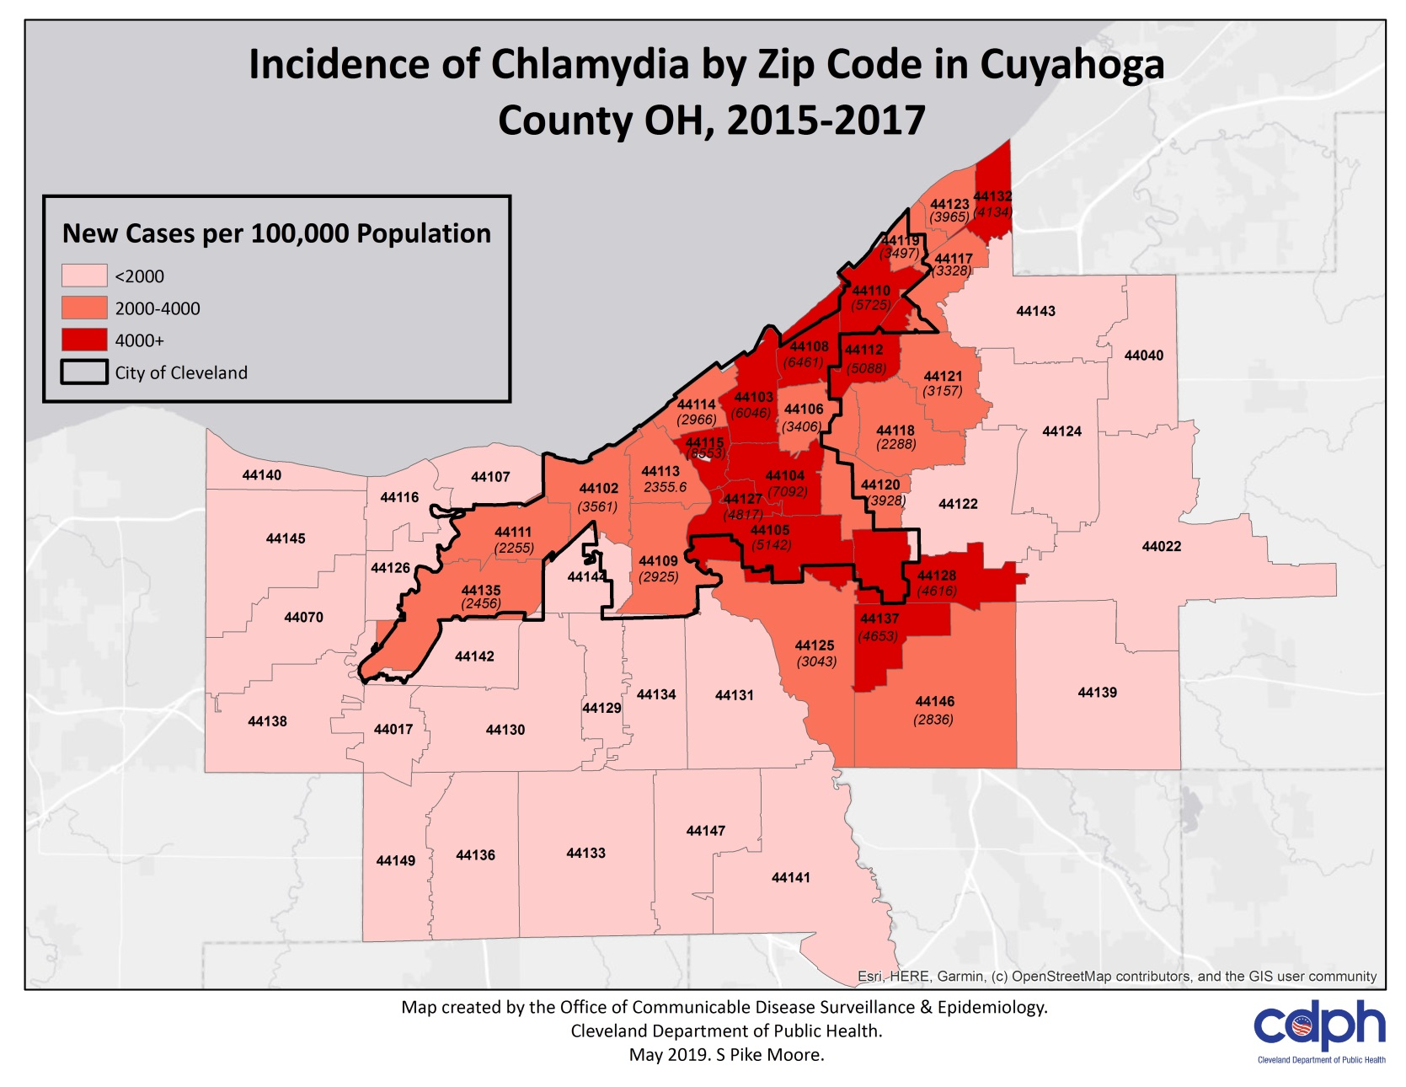
Incidence of chlamydia by zip code, cuyahoga county

Slide 21
Characteristics of new chlamydia cases by county

Slide 22
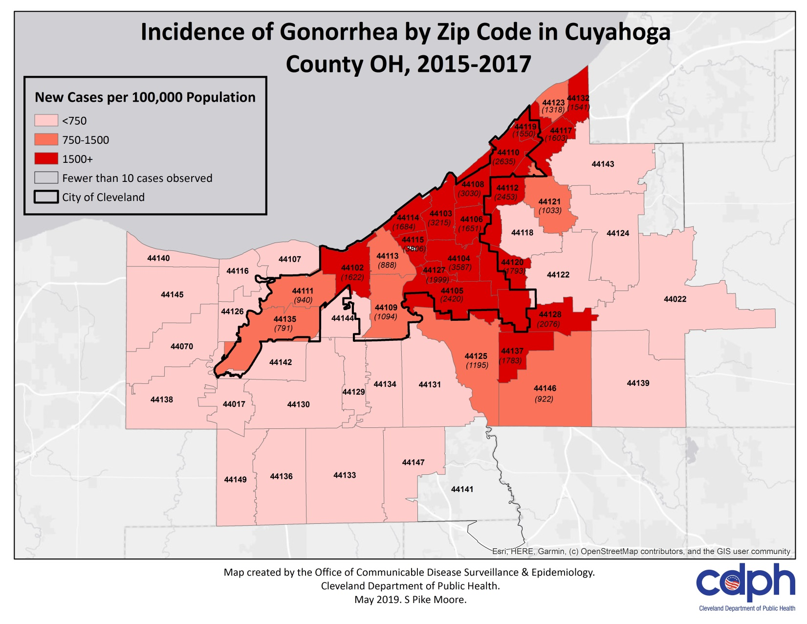
Incidence of gonorrhea by zip code, cuyahoga county

Slide 23
Characteristics of new gonorrhea cases by county

Slide 24
Sexual behaviors among youth in Cuyahoga county

Slide 25
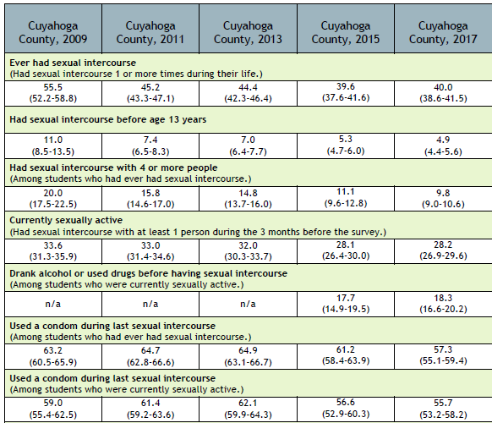
HS Youth risk behavior survey, cuyahoga county, 2009-2017
Since 2009,
Fewer HS students report ever having had intercourse
Half as many HS students report having had intercourse with 4 or more people
The proportion who are currently active remains the same
Since 2009, fewer youth report condom use the last time they had intercourse
Source: Prevention Research Center for Healthy Neighborhoods at Case Western Reserve University (2018)

Slide 26
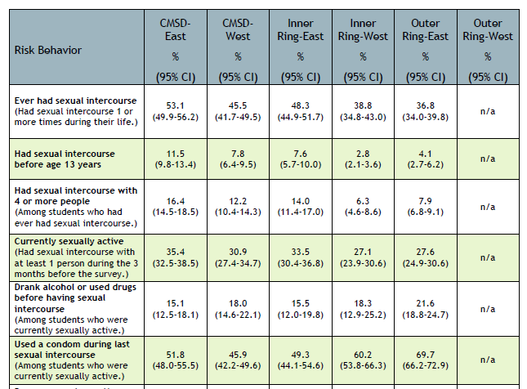
HS Youth risk behavior survey, cuyahoga county, 2009-2017
Cleveland HS students and Inner Ring East side students were more likely to
  Have ever had sex
  Had sex before age 13
  Had sex with 4 or more people
And were less likely to
  Have used a condom during last intercourse
Outer Ring East side students were more likely to
  Have drank alcohol or used drugs before having intercourse
Source: Prevention Research Center for Healthy Neighborhoods at Case Western Reserve University (2018)

Slide 27
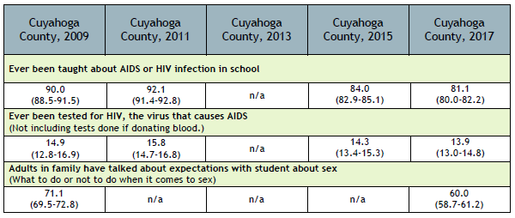
HS Youth risk behavior survey, cuyahoga county, 2009-2017
Since 2009,
Significantly fewer HS students report being taught about AIDS or HIV in school
Significantly fewer HS students reported having an adult in the family talk about expectations regarding sex
Source: Prevention Research Center for Healthy Neighborhoods at Case Western Reserve University (2018)

Slide 28

Comments/questions/suggestions

Slide 29

Thank you!
Contact Info:
Katie Romig, MPH, SIT Stephanie Pike Moore, MPH
kromig@city.cleveland.oh.us spikemoore@city.cleveland.oh.us
Office: 216-420-7743 Office: 216-664-4616
Data Source: Ohio Department of Health, Ohio Disease Reporting System (ODRS)
*Numbers may change if additional information is obtained.

